Slide 1
Herbivore and carnivore digestion

Slide 2
Herbivores are animals that eat plants
Their digestive system differ in structure because of their different diet
Animals cannot digest the cellulose in plant food

Slide 3
Cellulose is a good source of nutrients such as glucose - but the animal cannot break it down by it self.
The animal grinds up the food into small pieces and then uses microbes in the caecum to convert the cellulose to glucose

Slide 4
the caecum of a herbivore is very large compared to an omnivore or carnivore - The large surface area allows for absorption of the nutrients into the small intestine for digestion.

Slide 5
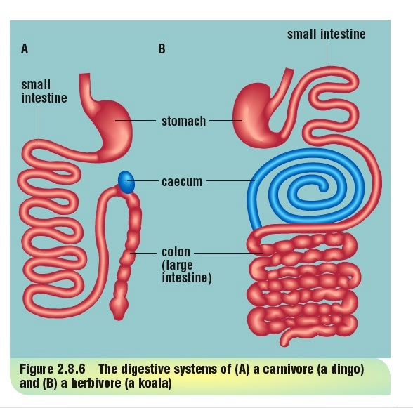

Slide 6
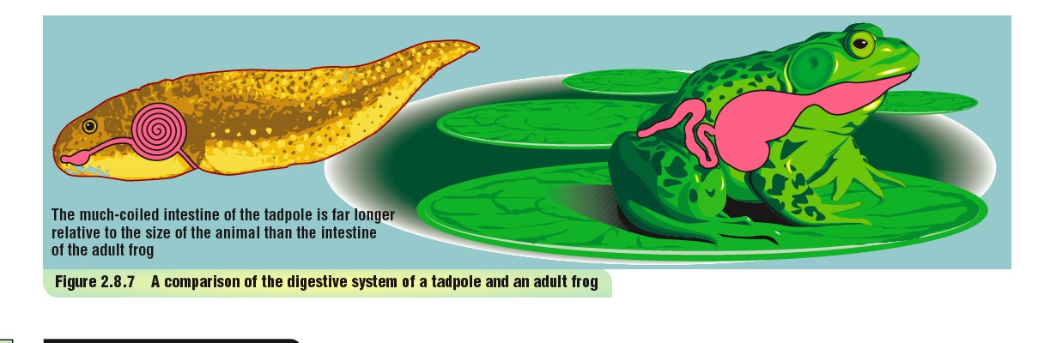

Slide 7
Animals such as the rhino or horse have very large stomachs
Kangaroos have an additional stomach near the beginning of their digestive tract

Slide 8
Ruminants - cows, sheep goats, giraffes have complex stomachs consisting of 4 chambers.
They rechew their food to help with the break down of the cellulose

Slide 9
Mechanical digestion
Carnivores and omnivores
Teeth - canines, incisors -designed to cut and tear food - mechanically cut and grind food
then digestion breaks food into smaller molecules ready for digestion

Slide 10
Mechanical digestion
Herbivores
Grind food to break cells
Re chew food

Slide 11
Enzymes
Food is initially broken down mechanically in the mouth by chewing.
Digestion (the breakdown into glucose, amino acids and fatty acids) takes place throughout the digestive tract using various enzymes

Slide 12
Amylases digest starch to glucose
They are present in saliva as well as produced in the pancreas.
Cellulose is unable to be digested by animals and requires the presence of a bacteria in the gut to break down the cellulose to glucose for absorption

Slide 13
Proteases digest proteins.
They are released in the stomach and by the pancreas.
They digest proteins to amino acids which are able to be absorbed into the blood stream for use throughout the organism

Slide 14
Lipases digest fats to fatty acids and glycerol.
Lipases are produced by the pancreas and released into the gut in the duodenum
The fatty acids are emulsified (made more water soluble) by bile produced by the gall bladder and are absorbed into the lymph system of the body.

Slide 15
Intestines of both herbivores and carnivores are thin, have a large surface area and are richly supplied with blood vessels to enable to transport of the digested material to all parts of the body.

Slide 16
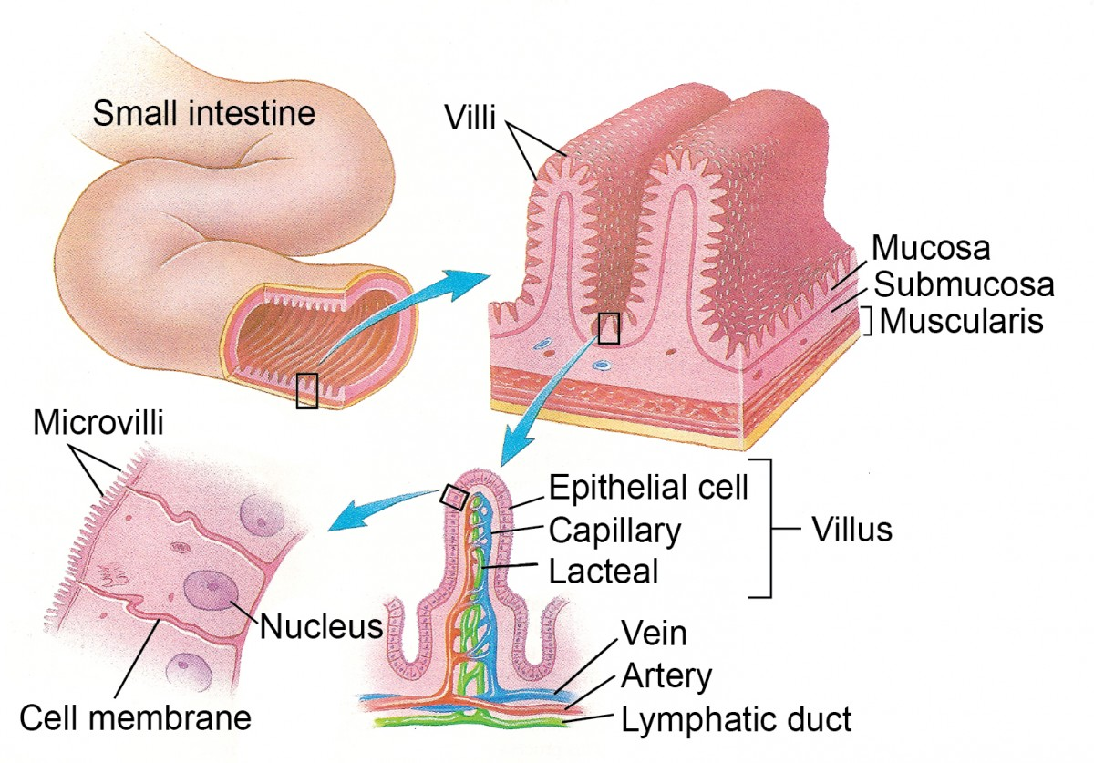
Thin, highly vascularised, large surface area

Slide 17
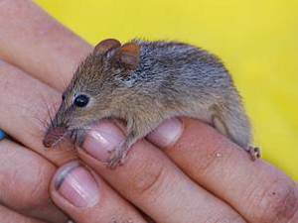
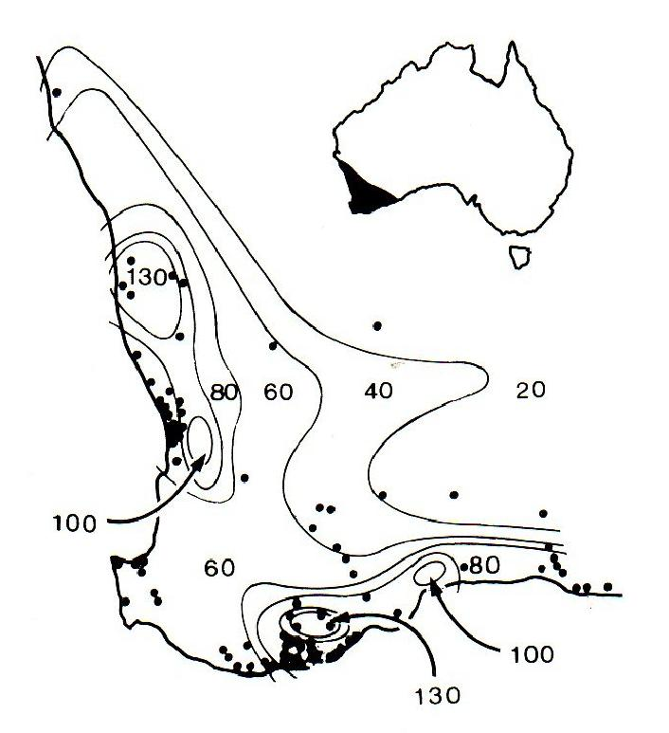
A highly specialised WA animal - extension
http://www.honeypossum.com.au/video.php

Slide 18
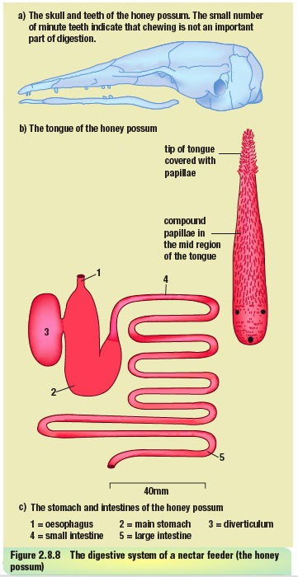

Slide 19
Honey possum
Only eat pollen and nectar
tongue specialised
covered with papillae -
rough ridges on the top of mouth to remove pollen
Stomach has two chambers

Slide 20
Honey possum
Stomach does not produce pepsinogen (protein digestion)
Caecum absent
Small intestine and large intestine difficult to distinguish between.

Slide 21
Honey possum
teeth small set into narrow pointed jaw for putting into flowers
canines and incisors premolars and molars all flat with round tips

